Slide 1


Slide 2



Vs
University of Kelaniya
University of Sri Jayawaradanapura

Slide 3



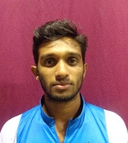
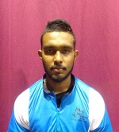
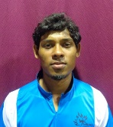
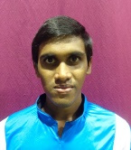
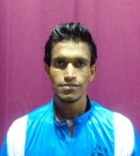
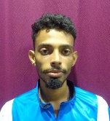
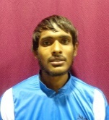
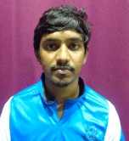
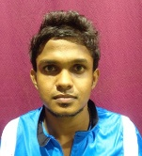
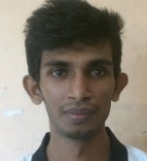
University of Kelaniya
Weigh Class : 54 - 67 Kg
D.T.M.N. Tharanga
H.M.U.A. bandara
I.B.C.S.B. Weerapokuna
H.D. Abesinghe
J.L.B. Jayaweera
A.K.V.H. Abeyrathne
M.L.M. Silva
P.L.N.U. Corray
H.M.P.K. Ekanayake
K.R.I. Maduranga

Slide 4
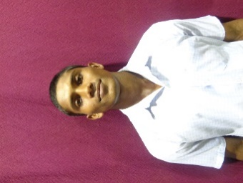
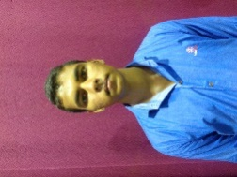
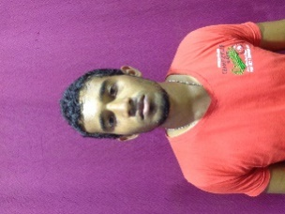
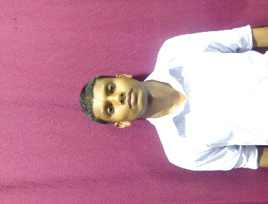
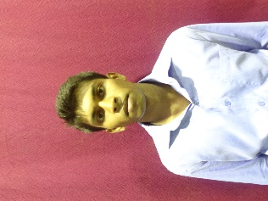
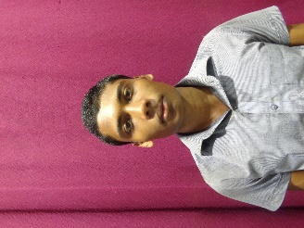
University of Sri Jayawardanapura
Weigh Class : 54 - 67 Kg
K.L.A.Y.I. Pushpakumara
P.M.D. Chathuranga
D.T.D. Gunasekara
B.L.D.M. De Silva
P.B. Wijebandara
H.M.U.M. Herath

Slide 6
Vs
University of Kelaniya
University of Sri Jayawaradanapura

